Slide 1
Media Board: Appeals
Courtney Lee

Slide 2
We request that at minimum, the Committee fund in full our printing costs ($84,859.91) and our equipment / online services ($26,839.03)

Slide 3
1. Media organizations are not businesses

Slide 4
“They are not operating like a business as they should, and we are subsidizing this.”
We have a right to be subsidized by the university
We should not be expected to turn a profit, only to manage our budgets responsibly
Efforts to earn revenue are a courtesy to the University, not a requirement
(no other groups on campus are expected to turn a profit. why should we?)

Slide 5
Event-based vs. content-based organizations
Tracking engagement is easier for event-based organizations than for content-based organizations
Student news and art add immeasurable value to campus that cannot be easily quantified

Slide 6
2. Print media is integral to our organizations

Slide 7
“They want to teach people how to go into print, but it is a dying industry.”
Growing interest in print media on campus
Valuable “Real World” Skills
Georgetown Voice Managing Editor currently gets paid by the Washington Post to work on print layout
Literary, arts, and culture publications’ print products are works of art themselves, and are necessary to club expression
Print news builds readership, publicity, and club presence on campus
(print cycles create camaraderie, foster an engaging club environment and make us more productive!)

Slide 8
Student Testimonials
To incorrectly assume that "nobody is reading the print version anyway", that magazines like Bossier that allow, in the singular most open, creator-driven, non-discriminatory and inclusive manner, a safe space for every opinion and expression are obsolete, and that it isn't print media such as this that creates the small, tiny, pocket of safety on this campus, is evidently an opinion that is based in privilege, insensitivity and ignorance. As a freshman starting at Georgetown last fall, there was no other space that made me feel like my voice and opinions were heard, and that gave me the love and support to truly flourish at this school, and to settle into this community with the comfort of knowing I was accepted. Taking that away from thousands of students at various points of their college life is truly an abominable and cruel act that I personally cannot believe the senate is enforcing.
-Akanksha Sinha, Bossier
To Senator Volpe, who asked "what is the real loss if we do not meet the funding requests of the media board:"
It's true that the loss may not be measurable in dollar signs and decimal points. But there are ideas, beliefs, convictions, stories, and life experiences that can’t be wholly expressed in an online article. The loss won't be felt by the GUSA senate. It will be felt by the womxn who no longer have platform to wholly express themselves, who can no longer see their experiences represented and validated, and who can no longer bring attention to issues that this campus has traditionally ignored. Just because you may not "lose" anything by silencing our voices, does not mean no that loss exists.
-Anna Gorman, Bossier

Slide 9
Student Testimonials
From The Hoya staff members:
“Especially in times like we’re facing now, we see a lot about inequalities to internet access, and by taking away print journalism, you’re taking away some people’s access to these resources.”
“A print newspaper adds an important additional level of accessibility for people without consistent internet access. The placement of The Hoya all around campus allows students and community members to pick up an issue at any time.”
“Without the production of a printed newspaper, I would not have met the wonderful, motivated, and talented group of individuals that make up the journalism groups on campus. Most importantly, I don’t think I would have ever gotten involved in journalism at Georgetown had it not been for printed copies of The Hoya being so visible around campus.”
“I think print really gives us a break from the screens and cords that tend to take over our lives nowadays. It’s also a valuable way for people to share their art, whether it be a story they wrote or a photo they took, and without print, I think those stories just don’t come across the same way and aren’t valued as much by the readers.”
“Print basically defines The Hoya. We assemble budgets every week and spend dozens of hours in the Leavey 421 office for the sole purpose of producing a print newspaper. Without print, The Hoya loses all sense of authenticity and student production.”

Slide 10
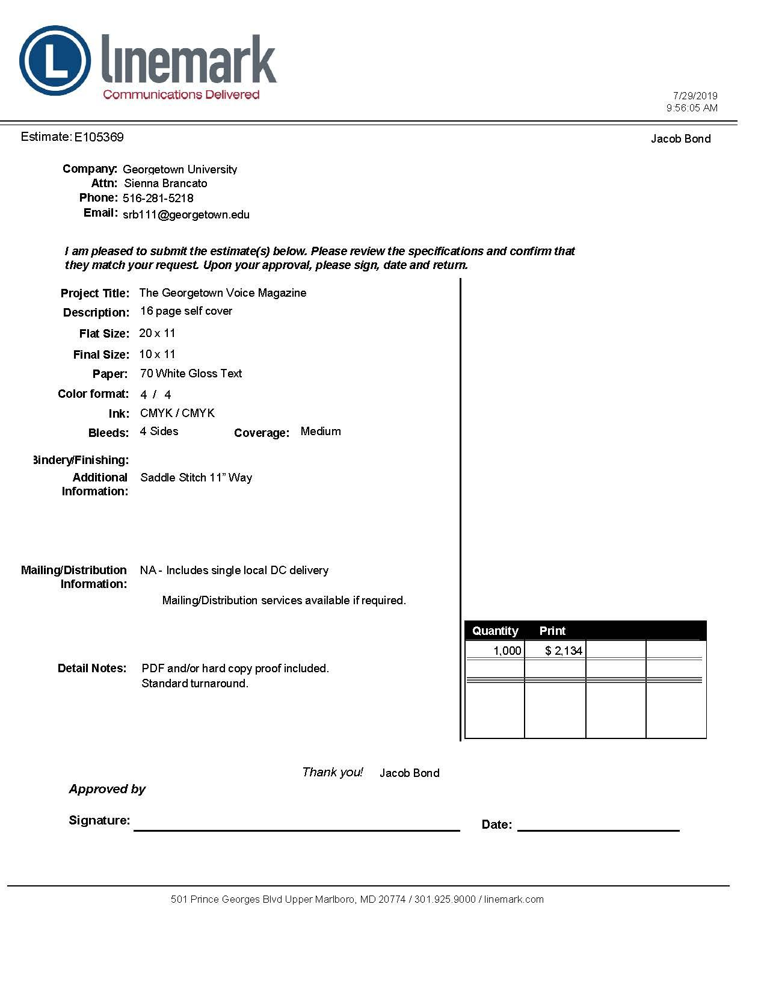
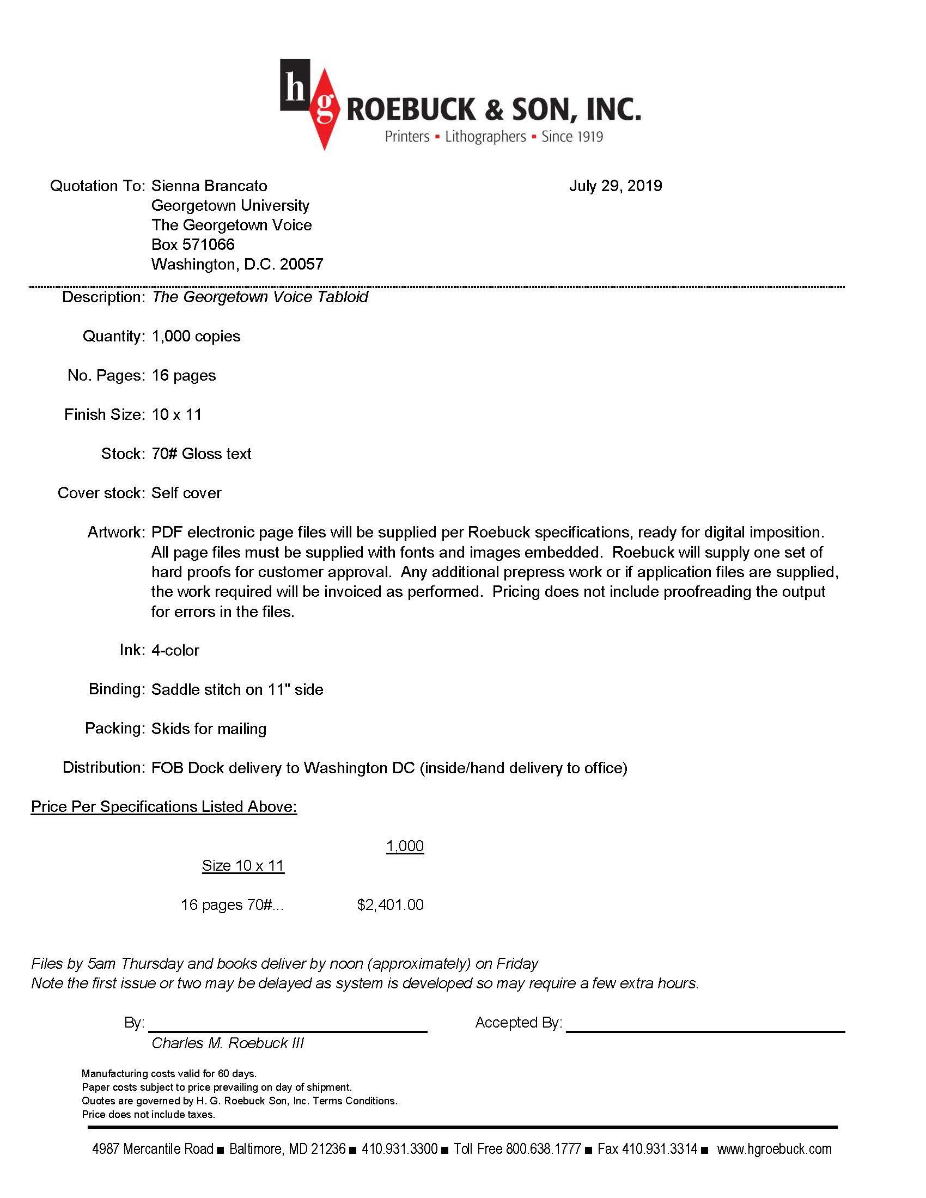

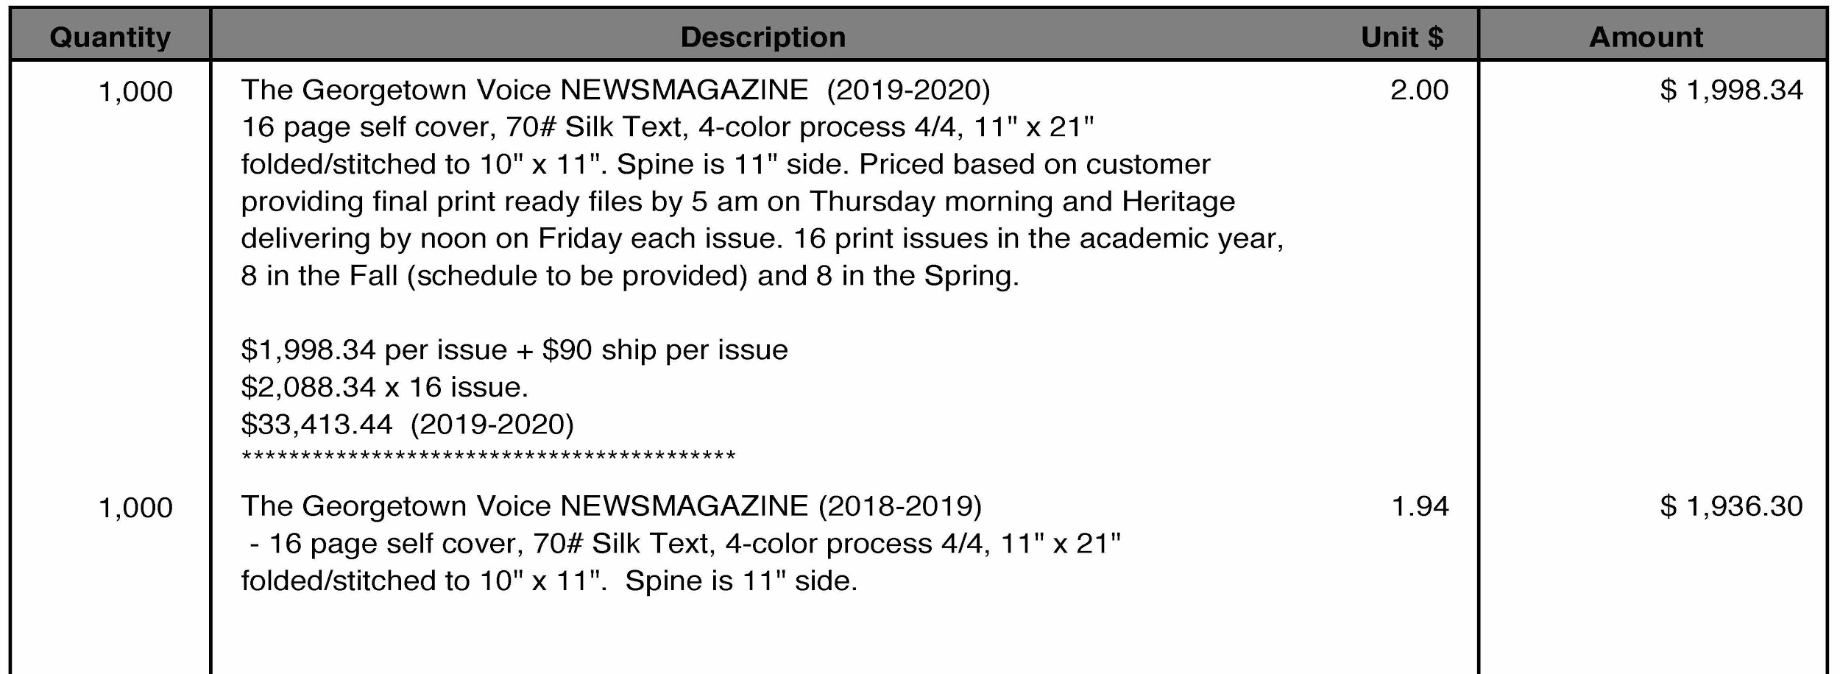
Printing Contracts
An example of different printing quotes The Voice has received. They choose the cheapest one for all of their issues.

Slide 11
Printing Contracts
The Hoya reached out to four different companies for our print contract last year. The Hoya currently uses the cheapest option for their print schedule (Chesapeake Publishing). This publisher also supports The Hoya’s ability to offer print subscriptions. For the last three semesters, people across the country have been paying to have the latest print issue of The Hoya sent to them, demonstrating print’s lasting value.
 | Chesapeake Publishing | Comprint | Park Press Printers | Narrow Passage Press
Price/Week | $1,741 | $2,030 | No quote (required minimum three-day turnaround) | $1,780
On-Campus Delivery | Included in price | Not included | Not included | Included in price
Nationwide Delivery | Included in price | Not included | Not included | Not included

Slide 12
3. Equipment and Online Services

Slide 13
“95% of their presentation was not about printing, but 30% of their budget was.”
For the past two years, we have requested more money to fund technology upgrades for the publications
We have needed equipment and online services for a while now, justifying the lack of focus on printing in our presentation
After all, our printing works! Our tech, on the other hand, does not.
(our technology requests should not invalidate our use of print media.)

Slide 14
4. Detrimental impact to new clubs

Slide 15
“This is tough love for the future.”
New media organizations require funds to build infrastructure
Forcing budget cuts will impact our ability to support them, too
Your unnecessary cuts force us to choose between maintaining print and growing our new organizations
(our campus loses diverse media sources when you cut down our options. that’s no future!)

Slide 16
5. Media Board restructuring

Slide 17
Media Board has always been financially responsible, and with Board improvements, we will be even more judicious in the future
Internal budget summit restructuring
We now require all orgs to defend their budgets prior to our roundtable discussion
Creation of new Budget Guide, which outlines financial priorities
Increase number of board members to fulfill all CAB and NCD responsibilities

Slide 18
Additional Testimonials

Slide 19
Student Testimonials
Anything I write on the importance of Bossier being in print will likely be inadequate. I do not have the words to describe what it feels like to see something you have poured your heart and soul into exist outside of the corners of the internet, in the real world, by your side as you travel from dorm to apartment to abroad and back again. Nor can I emphasize to you the joy and comfort of seeing a Bossier issue - any issue - on the coffee tables of my fellow alumni in their very first grown-up apartments.
When Tiffany and I first started Bossier, we were adamant about it existing in print. We knew that Bossier could not achieve its goal of empowering, inspiring, and providing a platform for underrepresented communities at Georgetown if it was only going to exist online. You need not look farther than the inscriptions on the insides of every issue describing Bossier as an older sister, a friend, or a confidant to understand that the artwork we create merits space on a page. There is no denying that having a tangible magazine deepens your connection to the stories and emotions expressed before your eyes. Every coffee spill, dog ear, and annotated margin forges a deeper bond between one Georgetown student and another. We would not honor the bravery of the contributors who published if we prevented them from making these connections; nor would we respect the countless hours the graphic designers log on every single page, ensuring they have created an artwork on par with the pieces they were entrusted to display.
-Michele Dale, co-founder of Bossier

Slide 20
Student Testimonials
The reason that Bossier has always published in print twice a year is because each issue is intended to bookmark the important events of a semester from cover to cover. While we've always been devoted to our online issue and blog posts, what makes our print 'zine so special is the way each issue captures our contributors' personal experiences from a particular time, and curates them together to serve as a physical reminder of what went on that semester...I wrote this piece on the day I failed an econ final; I mentioned intersectional feminism in my letter from the editor because it was at this point that I learned what the phrase truly meant; I made some great friends during sophomore spring and I'm so happy they're represented in these pages, and so on. Reducing/cutting print issues means taking away a special ritual, momento, experience from not only the Bossier staff, but all of the contributors and readers on campus—particularly at a time when it's clear that the way people experience Georgetown can change in an instant and needs to be written down and felt. That's where print publications like Bossier come in, and where I hope they'll continue to do so for semesters and years to come.
-Tiffany Tao, co-founder of Bossier

Slide 21
Student Testimonials
“Each week's issue of The Hoya is a snapshot of what life is like at Georgetown University that week — what mattered to students, what made the front page. Having worked extensively with the university's archives, I cannot emphasize enough the value of having print newspapers for historical work.”
“The print medium of The Hoya shapes each member's experience and is why The Hoya has been the most formative and meaningful experience of my time at Georgetown. I cannot imagine Georgetown without The Hoya, and I cannot imagine The Hoya without print.”
“Print is how all of my professors read The Hoya! For them, that’s how they would prefer to get their news, and I wholeheartedly agree with them. Print is also a large part of the cultural aspect of The Hoya. Particularly for the photo section, a lot of what we do relates back to what looks good in print and us formatting photos specifically for print. By taking that away, you take away our office time which therefore takes away the culture of our section as well.”
“The Hoya has a wide range of readers including many older adults and alumni. A large part of our readership comes from people who mainly read print journalism.”
“Having The Hoya in print is an important part of how Georgetown presents itself to possible applicants and their families. I’ve noticed that prospective students and parents will pick up a copy while on a tour. I also have seen Georgetown residents, who might not be directly involved with the university, reading The Hoya in print.”

